Slide 1
JABA
Juhani Aavanens Booking App
1/20

Slide 2

Vad?
Effektivitet
Påminnelse
Struktur
2/20

Slide 3
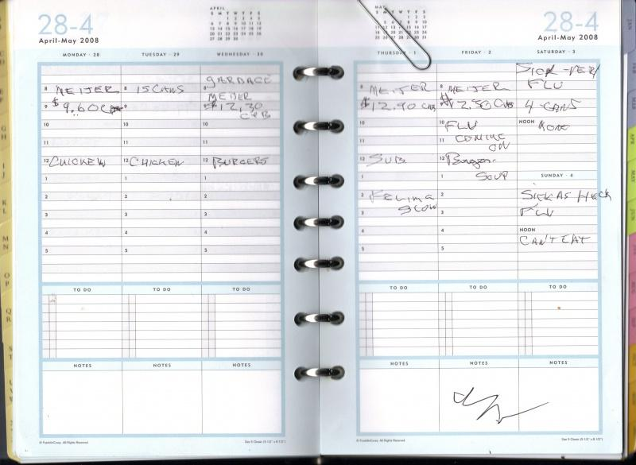
Problem?
3/20

Slide 4

Vem?
Småföretag
Medelålders ledare
Handfull anställda
Låg budget
4/20

Slide 5
Hurdana?
Målinriktad
Optimist
Driven
Initiativtagande
Visionär
Entreprenör
5/20

Slide 6



Hur?
6/20

Slide 7


Nytt?
7/20

Slide 8
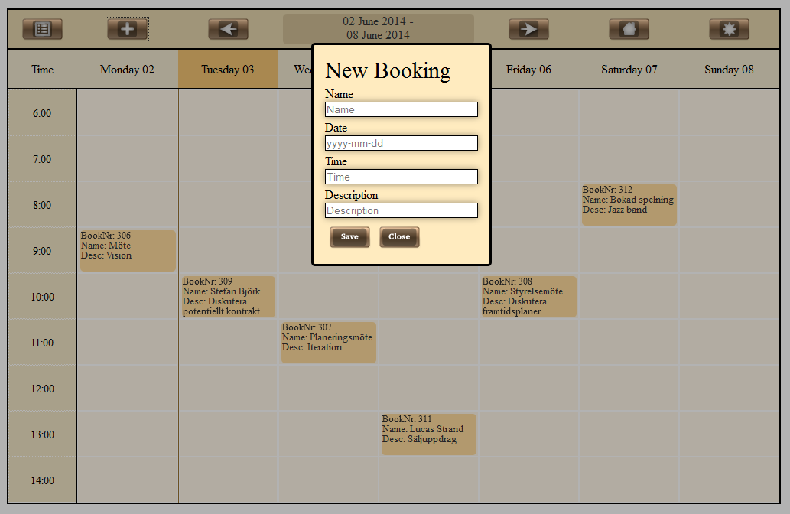
CRUD
8/20

Slide 9
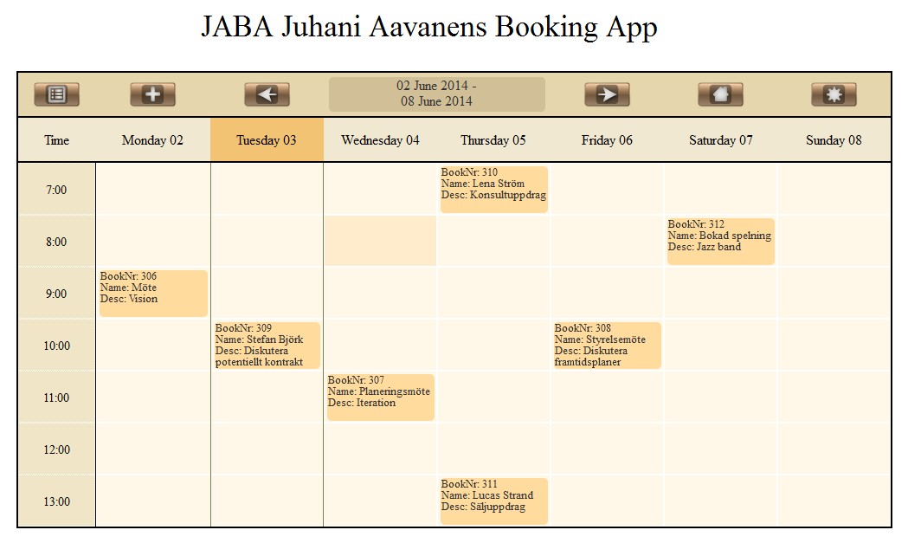
9/20

Slide 10
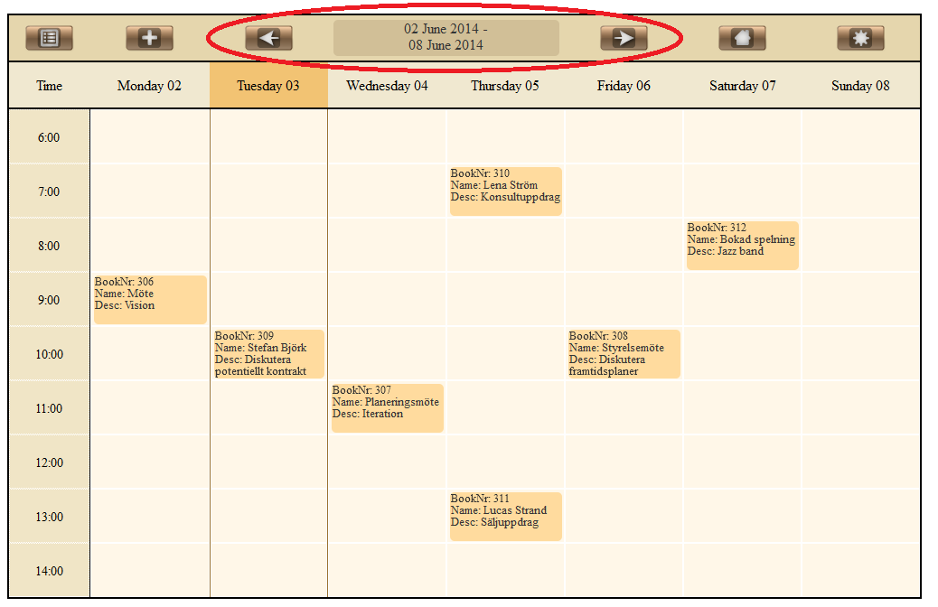
10/20

Slide 11
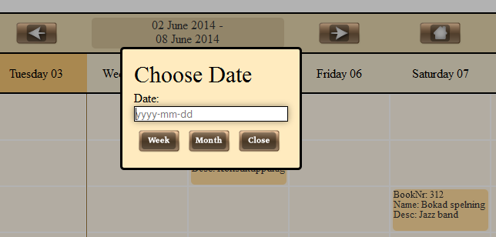
11/20

Slide 12
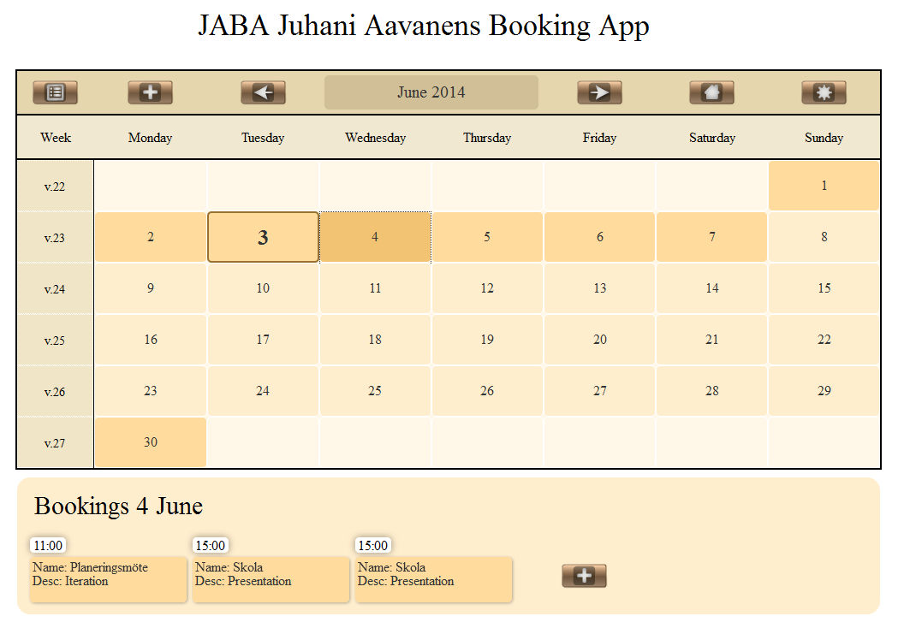
12/20

Slide 13
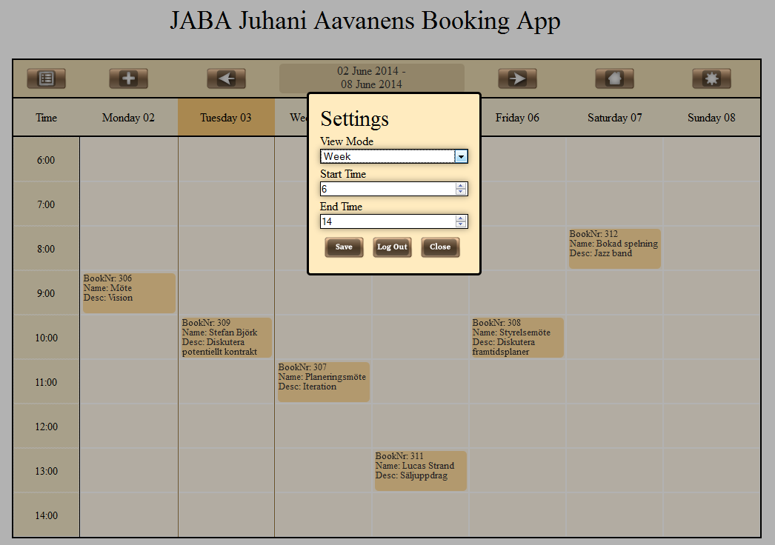
13/20

Slide 14
14/20

Slide 15
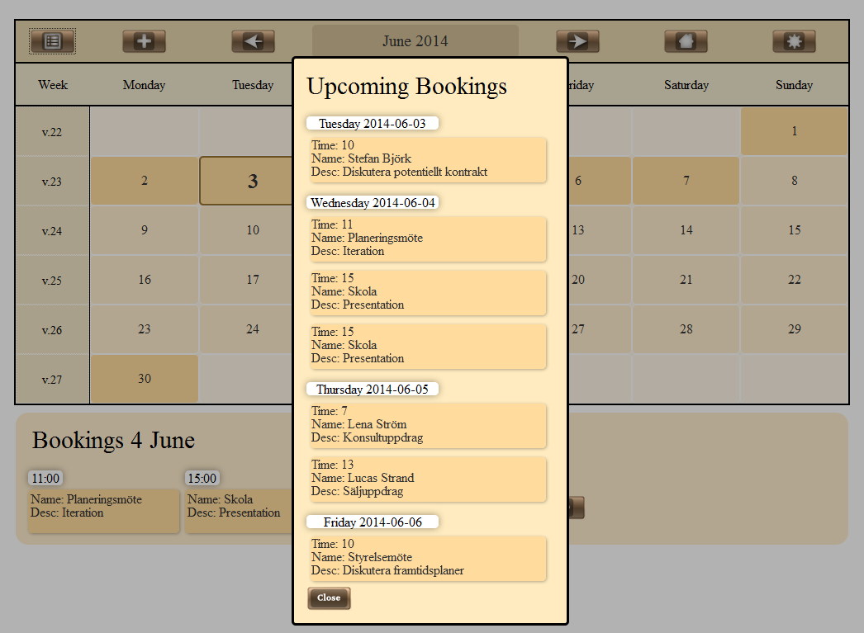
15/20

Slide 16
16/20

Slide 17
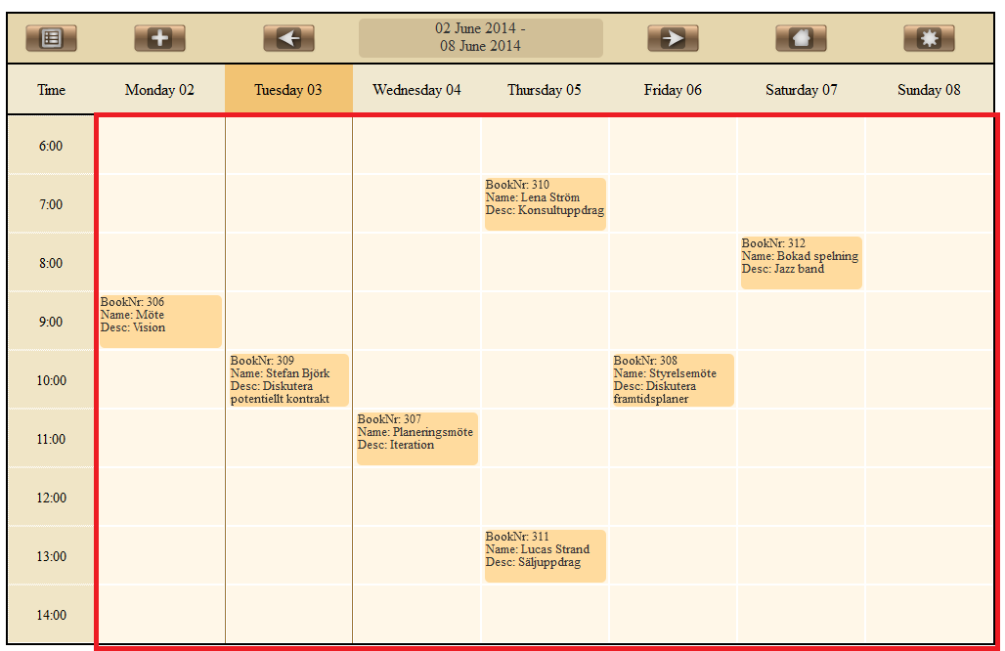
17/20

Slide 18



18/20

Slide 19

“We are products of our past, but we don't have to be prisoners of it.” -Rick Warren
“We do not learn from experience... we learn from reflecting on experience.”
― John Dewey
“No one is exempt from the rule that learning occurs through recognition of error.”
-Alexander Lowen
19/20

Slide 20


Framtid?
20/20

